Slide 1
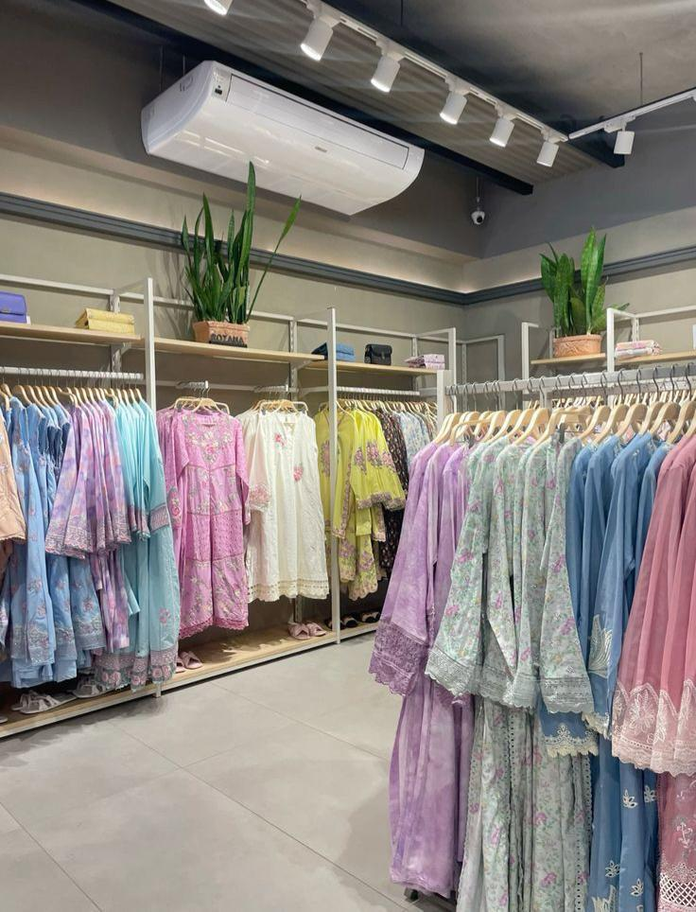
Sapphire
DIGITAL MARKETING PROJECT 01
Social media content planning
Decodelabs
Shafaq Zaman

Slide 2
About Sapphire
Sapphire is a prominent Pakistani fashion and lifestyle brand known for combining contemporary design with accessible fashion. The brand offers a diverse range of apparel and lifestyle products designed to reflect modern Pakistani aesthetics. Sapphire’s digital presence provides an opportunity to connect fashion-conscious audiences with new collections, seasonal trends, styling inspiration, and brand experiences through visually engaging social media content.

Slide 3
Primary Objective
The primary objective of this social media content plan is to develop a structured and audience-focused digital content strategy for Sapphire.
The strategy aims to: Identify and understand Sapphire’s core target audience. Develop relevant and engaging social media content ideas. Establish clear content pillars for consistent communication. Create a structured 7-day posting schedule. Encourage audience interaction through effective CTAs. Strengthen brand awareness and digital engagement.

Slide 4
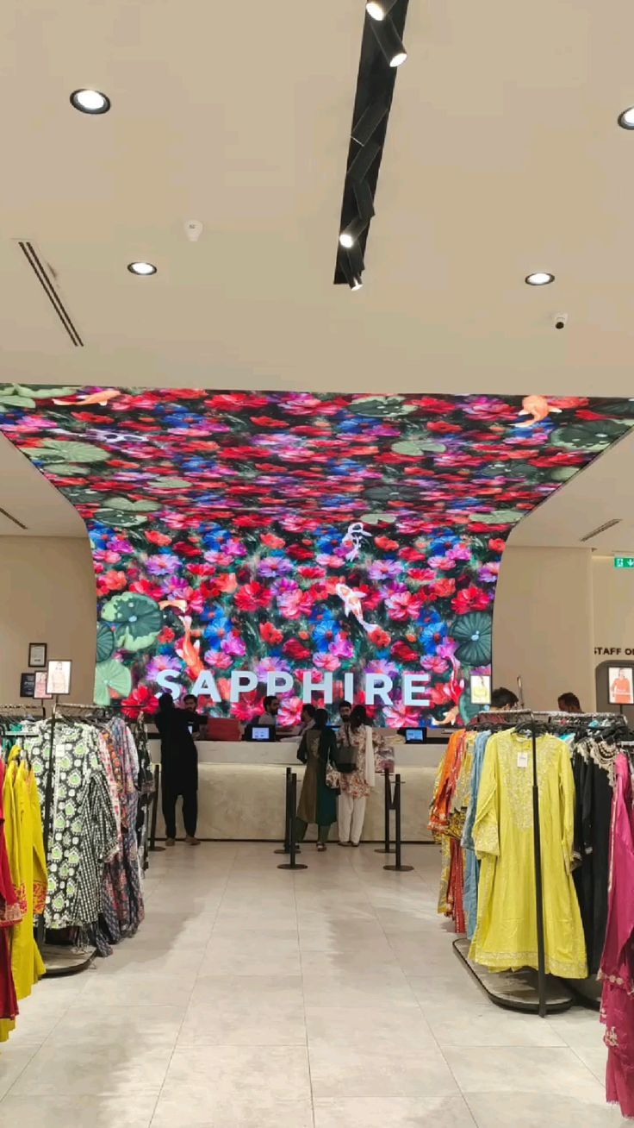
TARGET AUDIENCE
Sapphire’s social media communication should primarily target young, fashion-conscious consumers who actively explore fashion trends and use digital platforms for inspiration and shopping decisions.
Primary Audience Age: 18–35 years Gender: Primarily female Location: Major urban areas of Pakistan Lifestyle: Students, young professionals, fashion enthusiasts Income: Middle to upper-middle income consumers Digital Behavior: Highly active on Instagram and Facebook
Audience Mindset They value: Contemporary fashion Quality and design Styling inspiration Seasonal collections Brand aesthetics Convenience and online shopping

Slide 5
AUDIENCE INTERESTS & ONLINE BEHAVIOR
Sapphire’s target audience is highly visual and digitally engaged. Their purchase decisions can be influenced by how products are presented, styled, reviewed, and positioned online.
Key Interests Fashion trends New collections Seasonal outfits Styling ideas Festive fashion Beauty and lifestyle Fashion inspiration Influencer content
Digital Behavior Discover → Explore → Engage → Evaluate → Purchase The content strategy should therefore provide value at every stage of the consumer journey.

Slide 6
SOCIAL MEDIA CONTENT OBJECTIVES
CONTENT OBJECTIVES The social media strategy will focus on four major objectives: 1. Brand Awareness Increase Sapphire’s visibility through consistent and visually recognizable content. 2. Audience Engagement Encourage comments, shares, saves, polls, and other meaningful interactions. 3. Product Discovery Present collections through creative visuals, styling content, and product-focused posts
4. Conversion & Action Guide interested audiences toward exploring products, visiting the website, or making a purchase.

Slide 7
SAPPHIRE CONTENT PILLARS
Product Showcase | Highlight products, collections, details and features.
Inspiration | Provide outfit combinations and styling ideas.
Fashion & Trends | Connect Sapphire with current fashion conversations.
Brand Storytelling | Communicate Sapphire’s identity, aesthetic and values
Engagement Content | Encourage interaction through questions, polls and relatable content.

Slide 8
CONTENT IDEAS
1. New Collection Spotlight Introduce new arrivals through high-quality product photography and concise product-focused messaging. 2. “Style It Your Way” Show different ways to style the same Sapphire outfit for different occasions. 3. Behind the Look Present the creative process behind a campaign, collection, or fashion shoot. 4. This or That? Create interactive posts allowing followers to choose between two outfits or styles
Seasonal Style Guide Share curated outfit recommendations according to the season or occasion. 6. Detail Focus Highlight fabric, embroidery, prints, textures, colors, or design elements. 7. Community Feature Showcase customer styling or user-generated content to strengthen community participation.

Slide 9
CONTENT FORMAT STRATEGY
Carousel Posts
Instagram Reels
Styling inspiration New collection reveals Fashion transitions Trend-based content
Product collections Styling guides Multiple product details “How to Style” content

Slide 10
CONTENT FORMAT STRATEGY
Static Post
Stories
Product highlights Brand messages Campaign visuals Promotional communication
Polls Questions Quick updates Product links Audience interaction

Slide 11
CTA & ENGAGEMENT STRATEGY
Turning Content Into Conversations Every post should encourage the audience to take a meaningful action. Primary CTAs Explore the Collection Shop the Look Save for Later Share With a Friend Tell Us Your Favorite Vote Now Tag Someone Discover More ENGAGEMENT APPROACH Instead of simply broadcasting product information, Sapphire’s content should create opportunities for audiences to respond, participate, save, share, and return.

Slide 12
HASHTAG STRATEGY
Hashtag Strategy A balanced hashtag strategy can combine brand-specific, category-based, and discovery-focused hashtags. Brand Hashtags #Sapphire #SapphirePakistan Fashion Hashtags #PakistaniFashion #FashionPakistan #FashionInspiration #StyleInspiration Content-Specific Hashtags #NewCollection #StyleGuide #WeekendStyle #FashionTrends #OOTD

Slide 13
CONCLUSION
A successful social media presence requires more than frequent posting—it requires purposeful content, audience understanding, consistency, and strategic communication. For Sapphire, the proposed 7-day content plan combines product storytelling, fashion inspiration, interactive content, trend relevance, and community engagement. By maintaining a consistent content structure while adapting to audience interests, Sapphire can build stronger digital relationships and create a more engaging social media experience.

